Slide 1

Dark Matter Directionality:
Effect of Nuclear Recoil Direction Relative to Applied Electric Field on Ionization Yield in the LUX Detector
Nick Stern - author
Rick Gaitskell - advisor
Together with:
LUX-ZEPLIN (LZ) Collaboration
Brown University Department of Physics

Slide 2
Presentation Outline
What is Dark Matter?
  How do we know it exists?
  Why is it important?
How do we look for it?
  Indirect vs. direct detection
  LUX experiment overview
Resolving directionality
  Its relevance and potency in detecting dark matter
  How we can do it
Nuclear Recoil Analysis + Results
  Can we resolve the axial direction of a recoil in LUX?

Slide 3
Evidence for Dark Matter
Lots of Evidence
Galaxy Rotation Curves (1980)
Gravitational Lensing (1979)
Cosmic Microwave Background (1992)

Slide 4
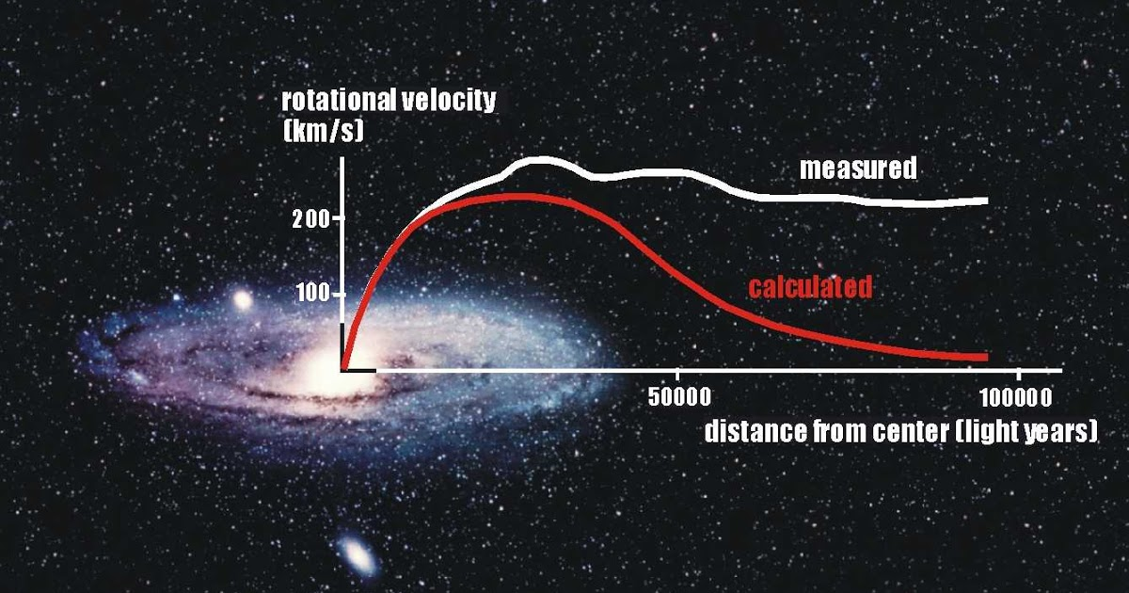
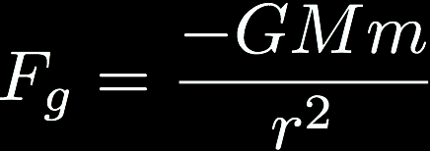


Evidence for Dark Matter - Galaxy Rotation Curves
Vera Rubin measured velocity curves of 21 edge-on spiral galaxies...
From Classical Mechanics:
Constant curve points to an unseen mass profile
Notes:
https://northtexasdrifter.blogspot.com/2015/09/galaxy-rotation-curve.html
https://en.wikipedia.org/wiki/Galaxy_rotation_curve

Slide 5
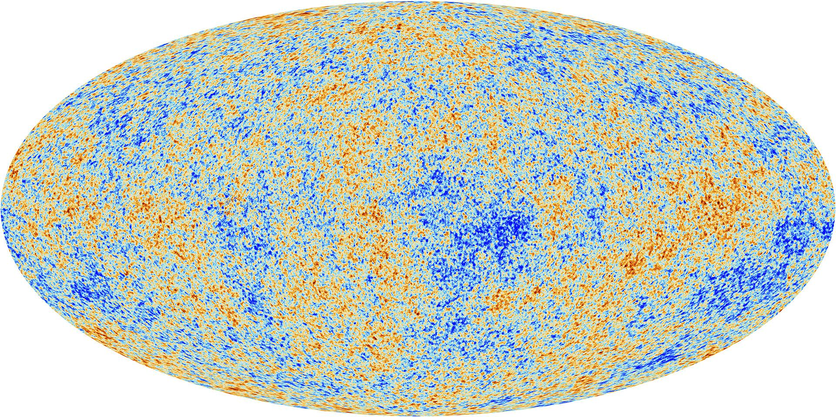
Evidence for Dark Matter - CMB
Cosmic Microwave Background (CMB) is the earliest visible light in the universe:
After ~300,000 years, universe expanded to where photons could travel unimpeded
Photons coming from overdense regions lost energy, leading to cold spots
Reveals vital info about the distribution of matter
Hot
Cold
Planck Collaboration (2013)
CMB temperature anisotropies show non-luminous matter is central to explaining large-scale structure evolution
Notes:
https://en.wikipedia.org/wiki/Cosmic_microwave_background#History

Slide 6
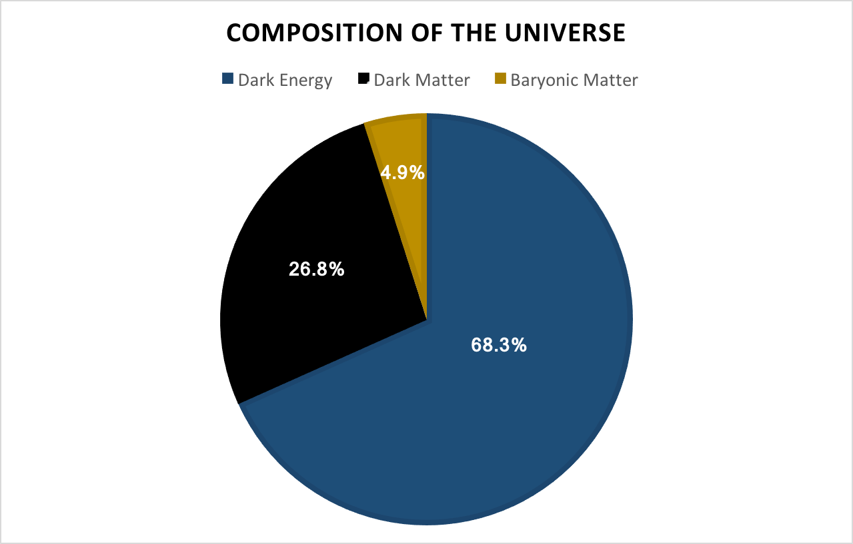
Why Does it Matter?
From 2013 Planck CMB Measurements:
Baryonic Matter - everything built from protons and neutrons i.e. galaxies, stars, people
Dark Energy - unknown force that causes the accelerated expansion of the universe
Dark matter - comprises 84% of material in the universe. Physicists are on a quest to figure out what it is!

Slide 7
What is it?
Dark Matter Candidates:
MAssive Compact Halo Objects (MACHO’s):
  Baryonic material that is hard to detect (i.e. black holes or neutron stars)
  CMB suggests non-baryonic dark matter
  Should have seen more of these objects with modern observational methods
Theoretical Extensions of Particle Physics
  Axion - solves Charge-Parity problem in quantum chromodynamics
  Sterile Neutrino - explanation for left-handed only chirality of neutrinos
Weakly Interacting Massive Particles (WIMP’s):
  Exotic particles that interact only via gravity and possibly the weak force.
  Masses range from ~ 1 to 1000 GeV/c² depending on the model

Slide 8

Motivation for WIMP’s
The Big Bang and “The WIMP Miracle”:
The early universe was extremely hot and dense (~10,000,000,000,000 ºC)
Matter and antimatter annihilate according to their cross section
  Cross section: probability two particles will collide and react in a certain way
Universe expands and the density decreases until annihilation stops
Idea: dark matter is a particle that self-annihilates w/ cross section similar to weak force interaction*
Result: the density at which dark matter stops annihilating is consistent with the density of dark matter we measure today!
Notes:
* Note – the weak force as a mechanism for interaction has since been ruled out, but some think there may be another “dark” mechanism a few orders of magnitude weaker than the weak force at play. Regardless, this was still one strong motivation for pursuing the WIMP hypothesis in the first place.

Slide 9
Searching for Dark Matter
Three Methods of Detecting Dark Matter:
Particle Collisions
  Collide subatomic particles to create theoretical particles with dark matter characteristics
Indirect Detection
  Look for byproducts of dark matter annihilation (gamma rays)
Direct Detection
  Observe the byproducts of a collision between a dark matter particle and some sort of target media - Large Underground Xenon (LUX) experiment.

Slide 10
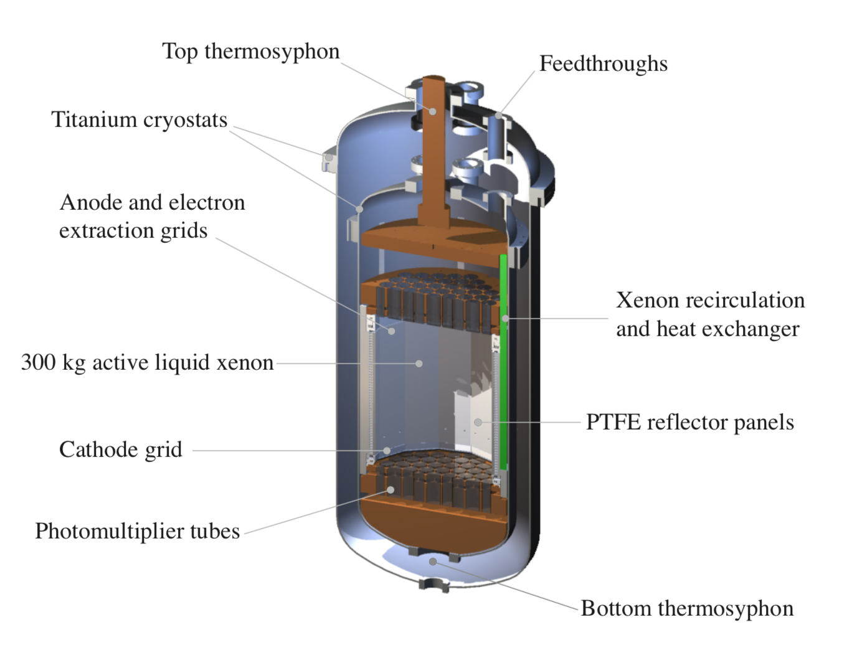
LUX Experiment
Large Underground Xenon (LUX) Detector:
370 kg of cryogenically cooled liquid xenon, 4850 ft underground in Lead, SD
Operational 2013 - 2016. Most sensitive in the world in 2016!
Objective: WIMP strikes xenon, generates signals picked up by top/bottom photomultiplier tube (PMT) arrays

Slide 11
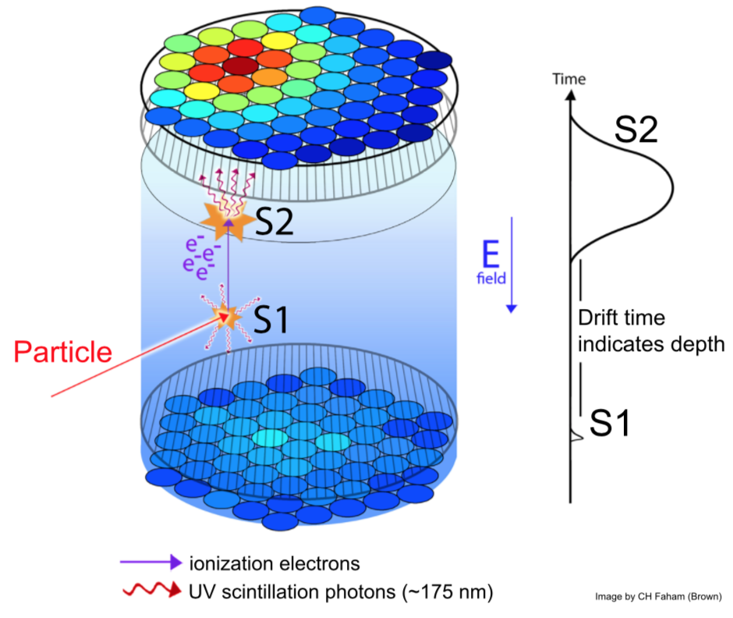
Signal Generation
Two types of signals:
S1 - photons released on impact
S2 - photons from electrons ionized in collision. Electrons drift up thru liquid surface into gas layer and undergo electroluminescence
Can resolve x, y, z coordinates of collision via hit pattern and ∆t.
Xenon transparency/PTFE panels

Slide 12
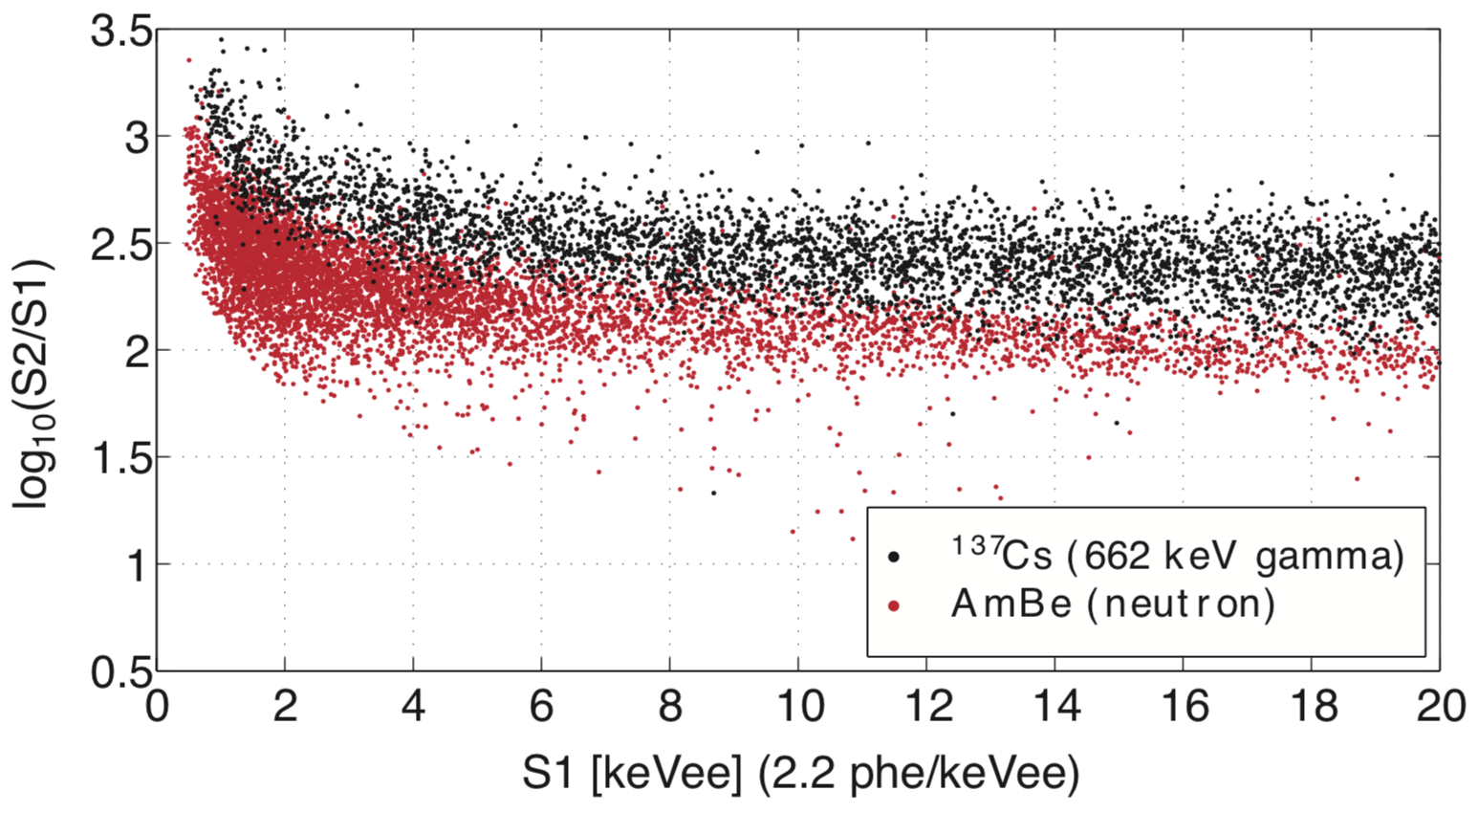
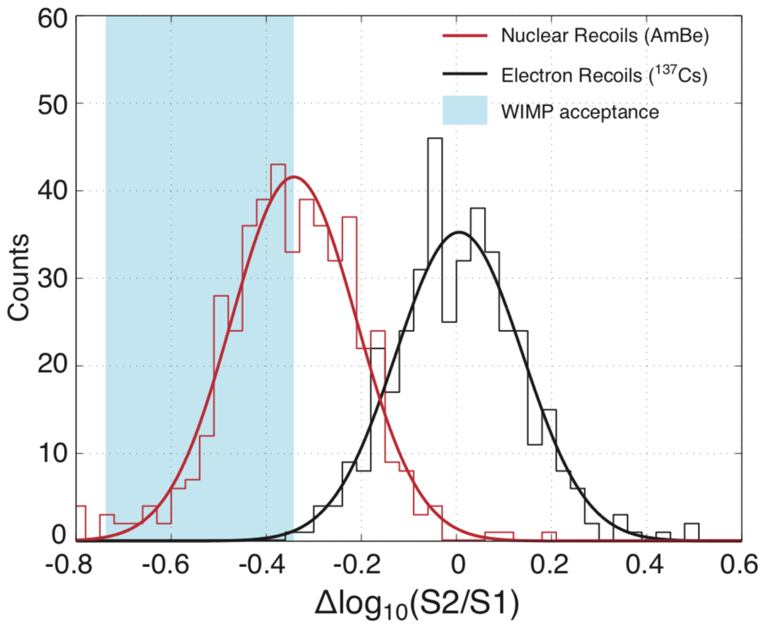
Background Discrimination
Methodology: Rule out everything but WIMP’s
Protected from atmosphere by rock barrier
Water tank w/ PMT’s to rule out muons/cavern radiation
Radiopure detector material
Xenon is stable + outer layer shielding
Electromagnetic recoil vs. nuclear recoil distinction w/ S2/S1 ratio
Characterize all other known reactions

Slide 13
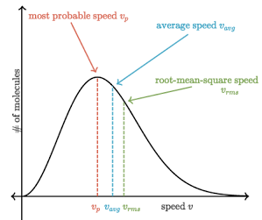
Dark Matter Directionality
Powerful way to identify WIMP signature
Key facets:
Presume galactic dark matter is in isotropic halo w/ Maxwell-Boltzmann velocity distribution peaking @ ~200 km/s
Solar system orbits galactic center @ ~230 km/s
WIMP’s scatter isotropically in center of mass (CM) frame of reference

Slide 14
Dark Matter Directionality
Solar system’s motion
More WIMP recoils along axis of incident direction
Galaxy Frame
Solar System Frame
V1’
WIMP
V1’
Xenon
V1
V2
CM
V1
V
V2’
V2’

Slide 15
Dark Matter Directionality
Importance of Directional Resolution:
Asymmetry is substantial
  Simulations indicate order of magnitude difference
WIMP incident direction changes by the hour
  Unique variance can differentiate WIMP recoils from all laboratory background contamination
Fewer events are needed for statistical significance
Events that follow this physical/temporal trend would be a “smoking gun” signal for dark matter.

Slide 16
Directional Resolution in LUX
Can we resolve the axis of a recoil in LUX?
Idea: Modulation in S2 wrt recoil direction from varying amount of recombination emission
Electrons
Electrons
E-field
Vs.
E-field
Xe Nuclear Recoil Track
Xe Nuclear Recoil Track

Slide 17
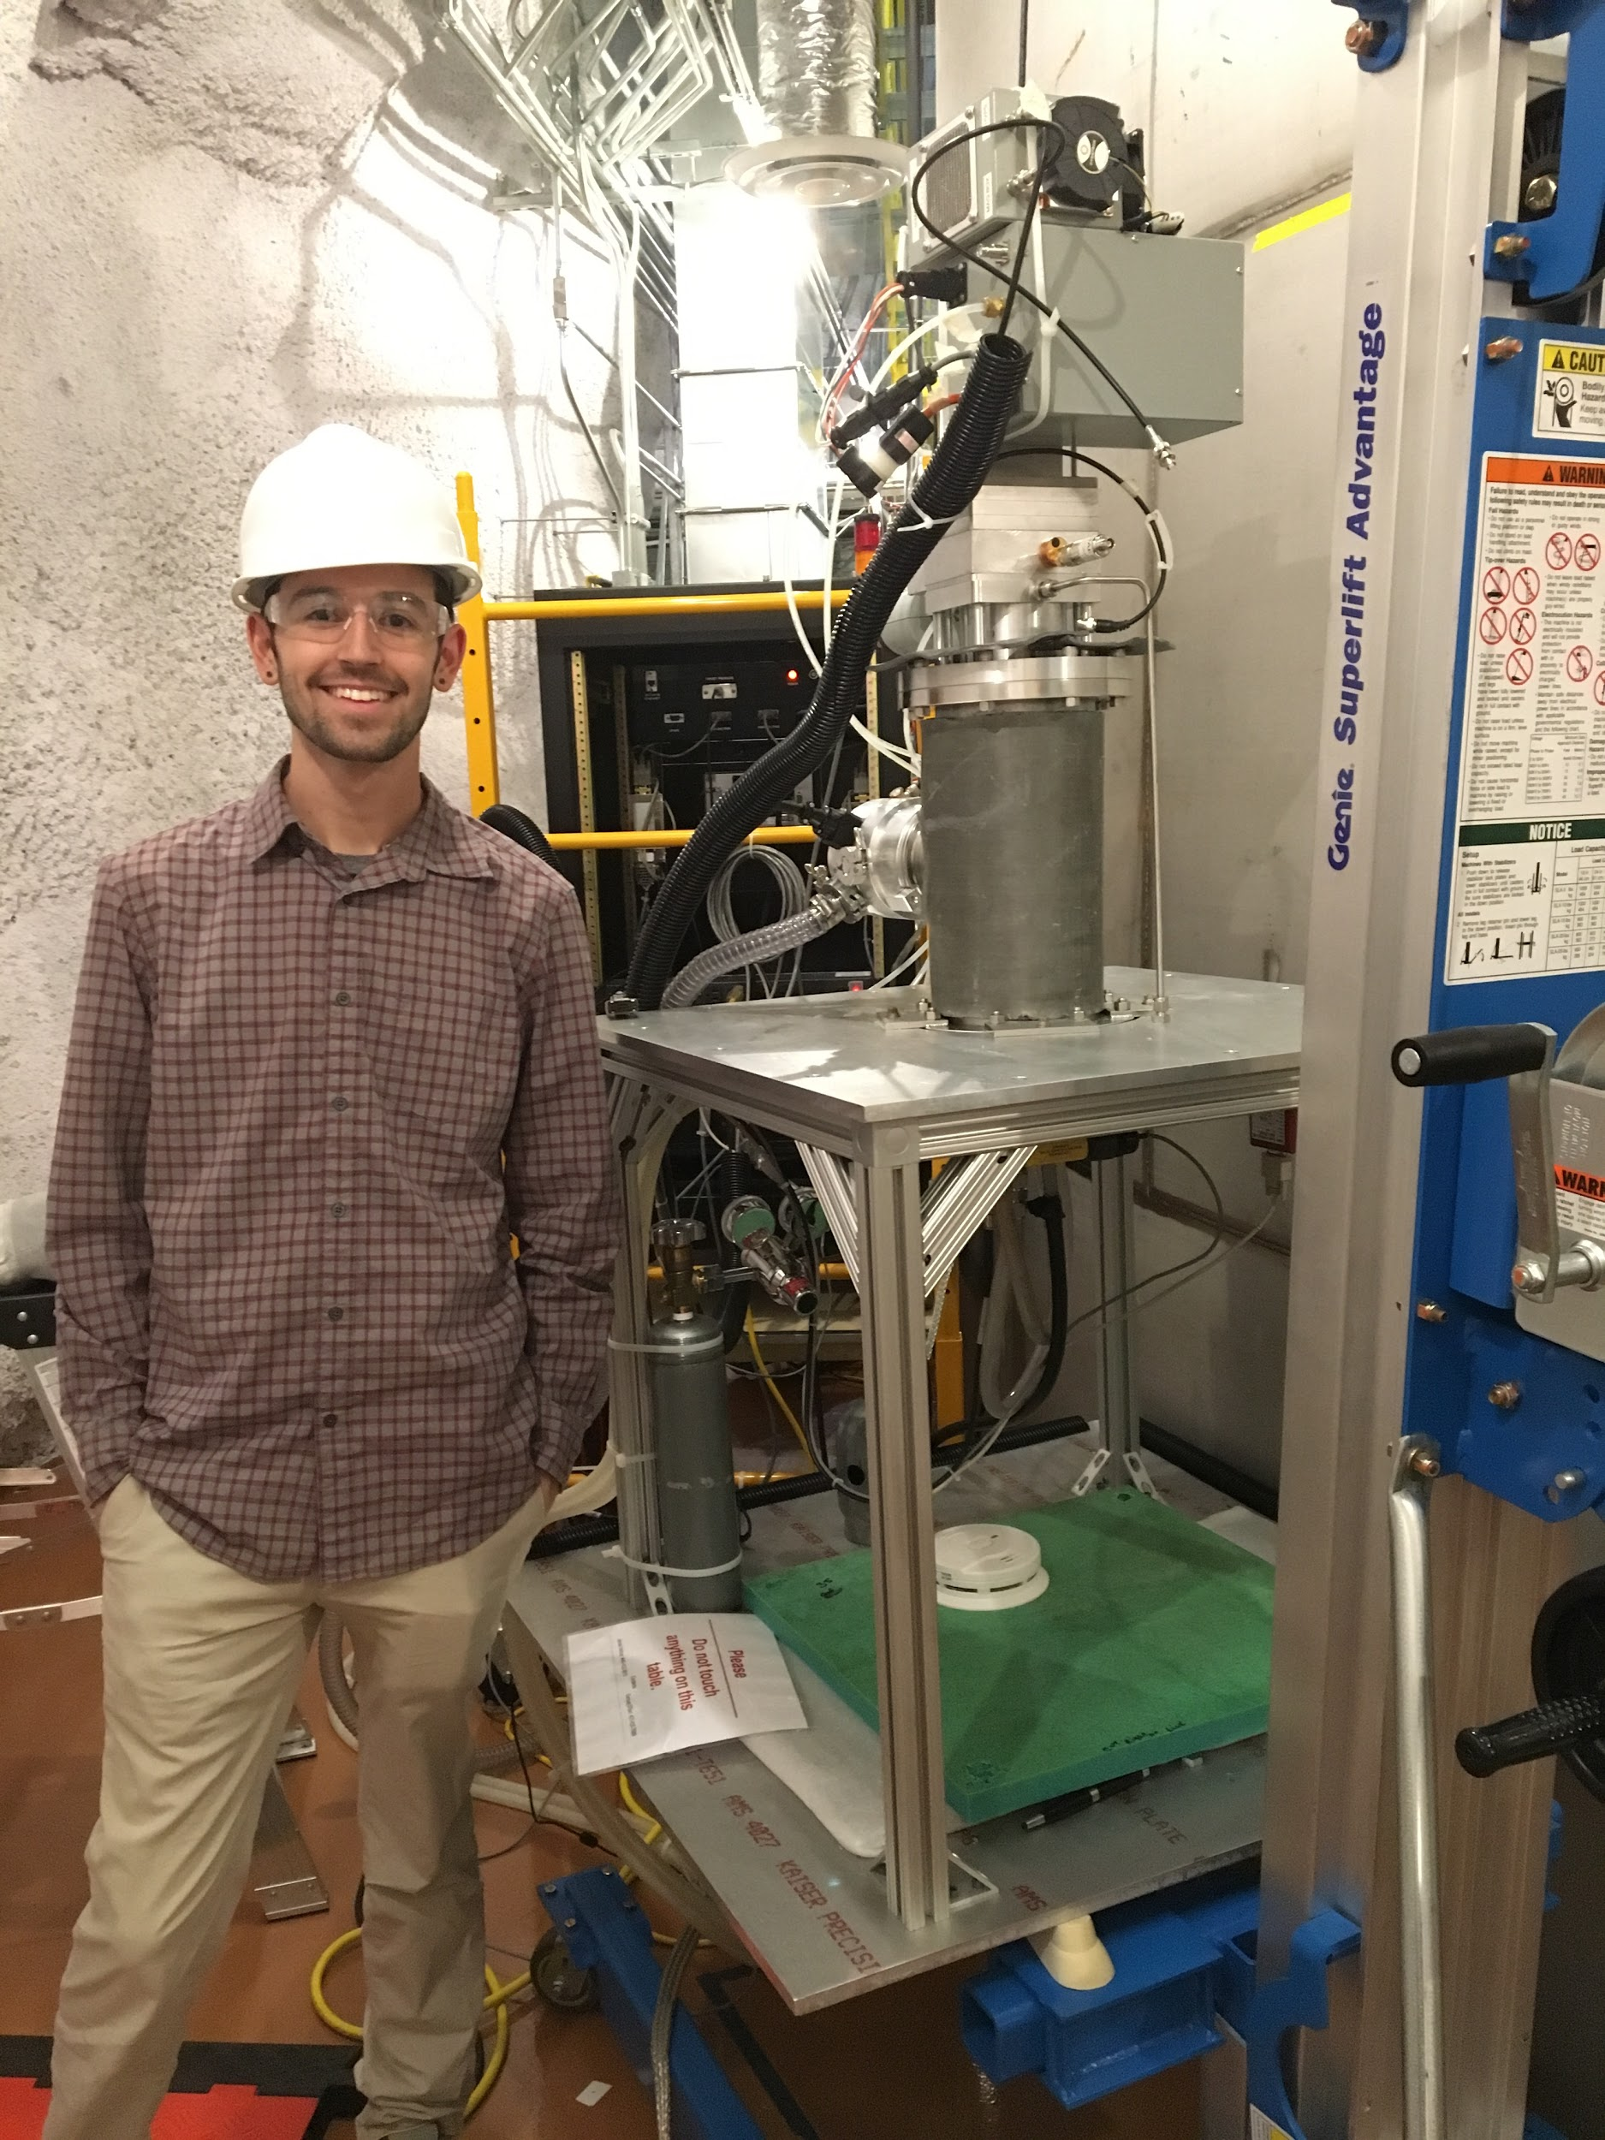
Nuclear Recoil Data
Neutrons are used to calibrate for nuclear recoils in LUX
D-D neutron generator is placed outside water tank near conduit tube
Generates 1,000,000 monoenergetic neutrons/sec! (2.45 MeV)
~10-15 scatters per second in LUX
107.2 live hours of nuclear recoil data
Question: Is the S2 signal dependent on the angle between the xenon nuclear recoil track and the electric field in LUX?

Slide 18

Nuclear Recoil Analysis
Event Selection Process:
Nuclear recoils
Double scatters
Ensure Incident Neutrons
  From generator
  2.45 MeV
Elastic Scatters only
Minimize background events
Filters
First scatter > 15 cm from entry point
First scatter within 2.5 cm radius of neutron beam center
Both scatters within fiducial radius of 21 cm
Electron drift time between 30 and 290 microseconds
Separation between scatters > 5 cm
Width of S2 pulse < 775 nanoseconds
Second S2 < 1500 detected photons
S1 > 300 detected photons
First S2 < 5000 detected photons
First S2 > 36 detected photons
Second S2 > 225 detected photons

Slide 19
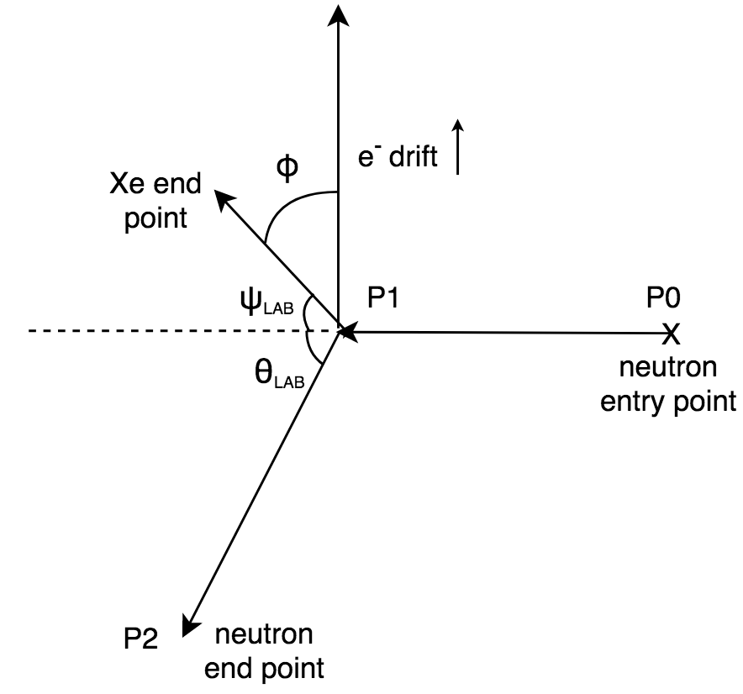



Making the Measurement
Can approximate LUX E-field as vertical
Define φ to be angle between Xe recoil vector (Xe) and vertical vector (E)
Variables we know: P0, P1, P2, and ϴ
From Classical Mechanics:
Can rotate neutron vector to get vector in Xe direction. Then:

Slide 20
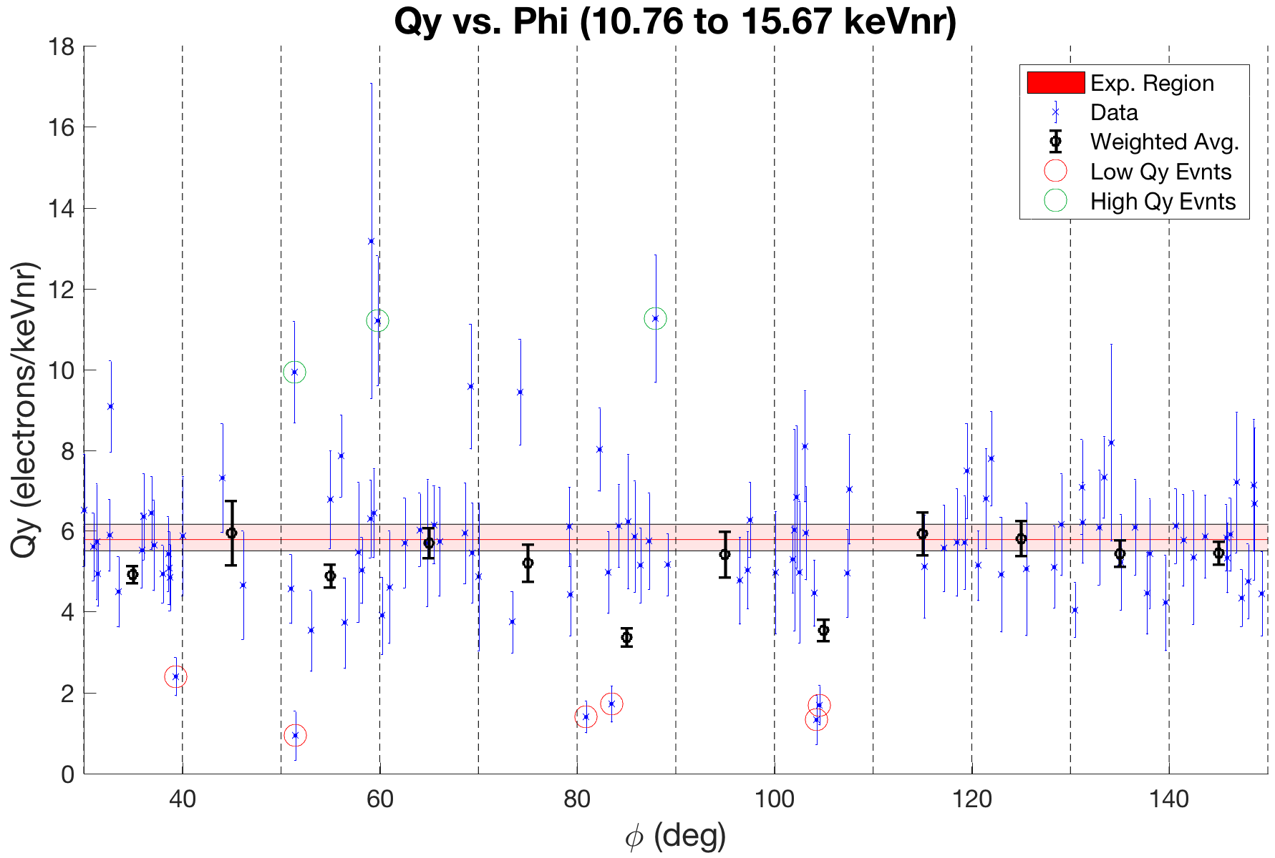
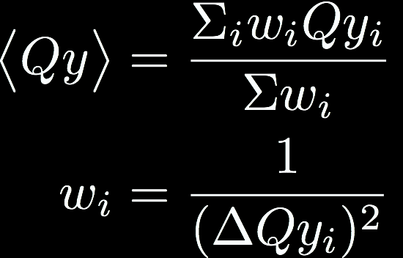
Qy vs. φ
Normalize by recoil energy → Qy
109 Events
Weighted Avg
Outliers were identified

Slide 21
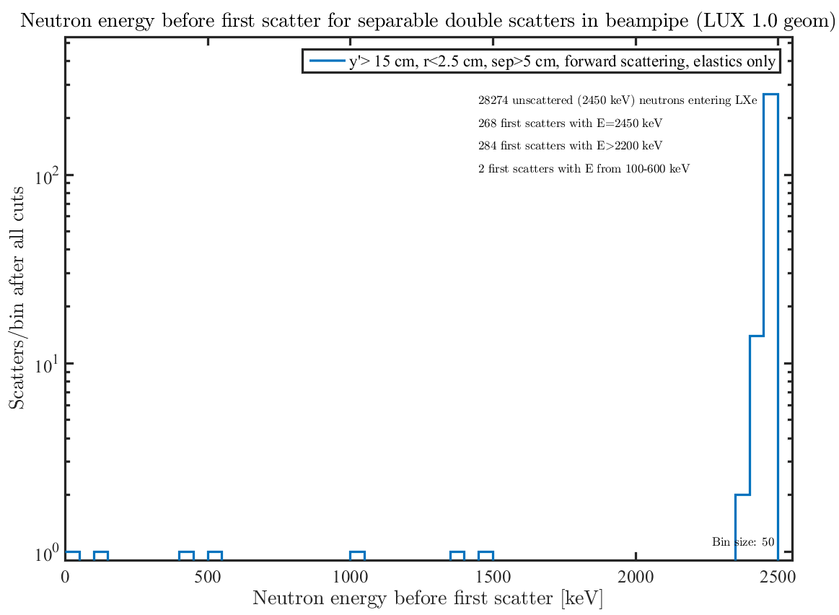
Outlier Characterization
Avenues Explored:
Misordered scatters?
Anomalous pulses?
Overlapping pulses?
Electromagnetic recoils?
Close scatters?
Low energy neutrons?
Monte Carlo w/ LUXSim:
~ 3% of neutrons are low energy

Slide 22

Likelihood Analysis
Probability Density Function (PDF):
Describes distribution about expected Qy
Grounded in physics
Each data point gets likelihood value from PDF
Null Hypothesis: PDF has no φ dependence
Alternate Hypothesis: PDF does have φ dependence
Wilk’s Ratio Test:
Gives chi-squared statistic w/ 1 dof

Slide 23
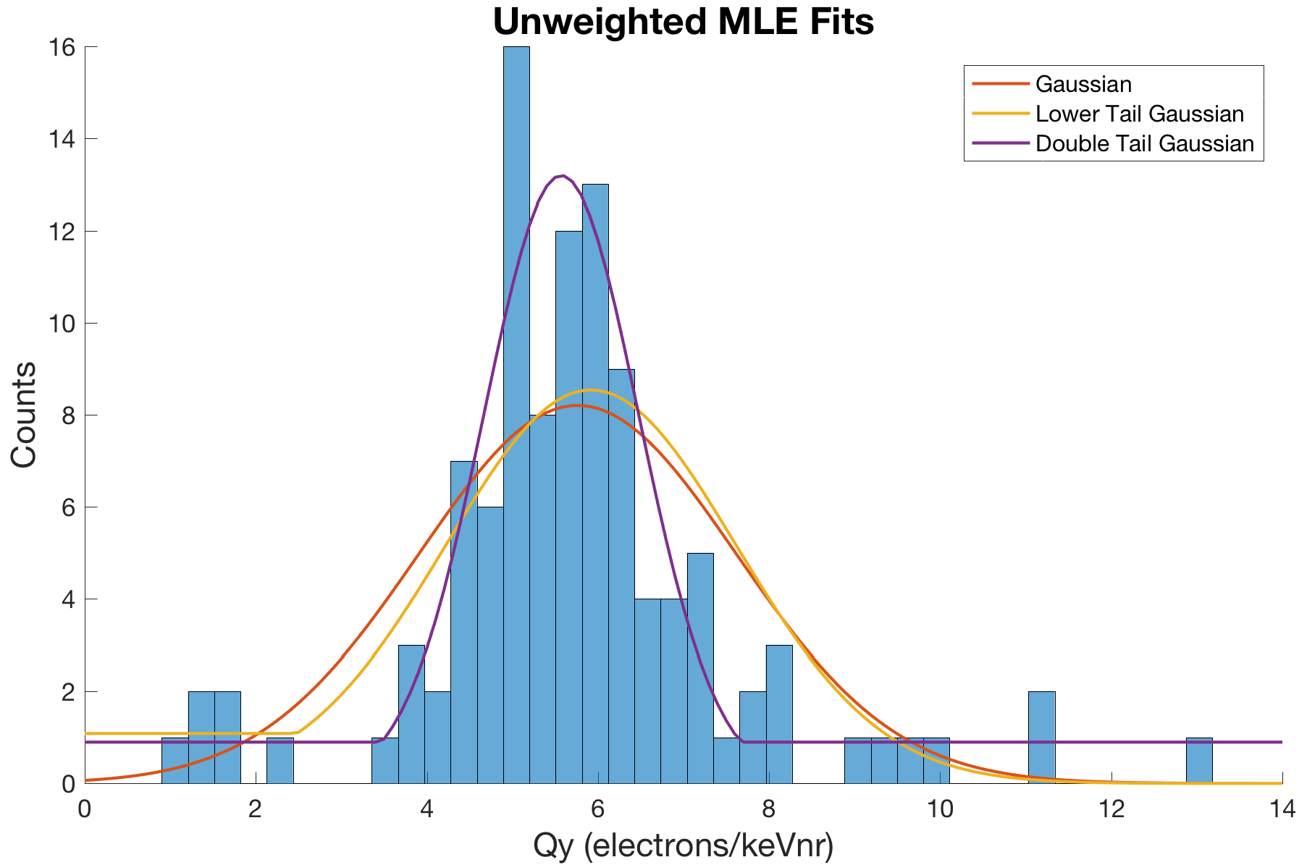
Maximum Likelihood Estimation
Double tail Gaussian is good fit but unjustified
Lower tail and regular Gaussian fits are justified but spread b/c of outliers
High points have high uncertainty…
PDF does not recognize that

Slide 24



Weighted Likelihood
Remedy: Implement weights inversely proportional to uncertainty:
Two weight schemes:

Slide 25
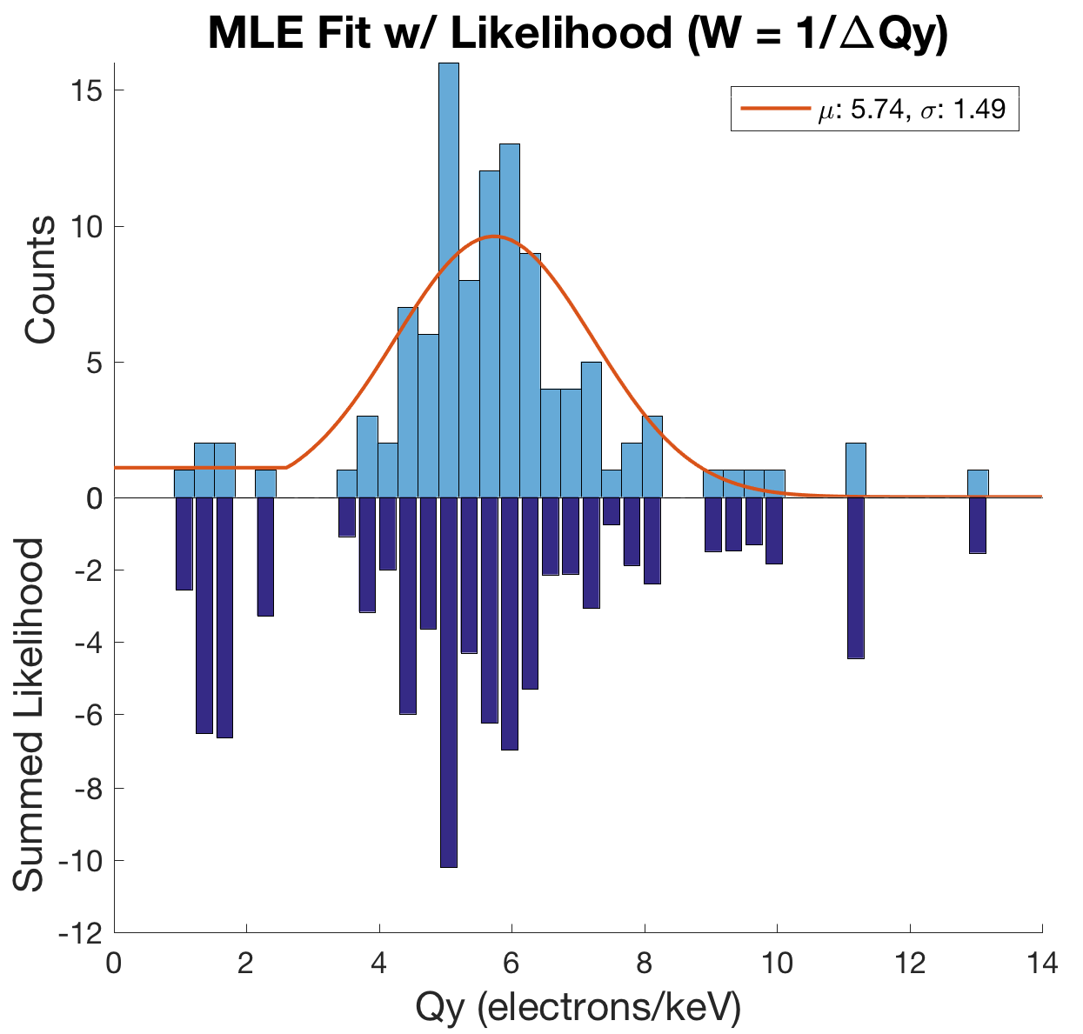
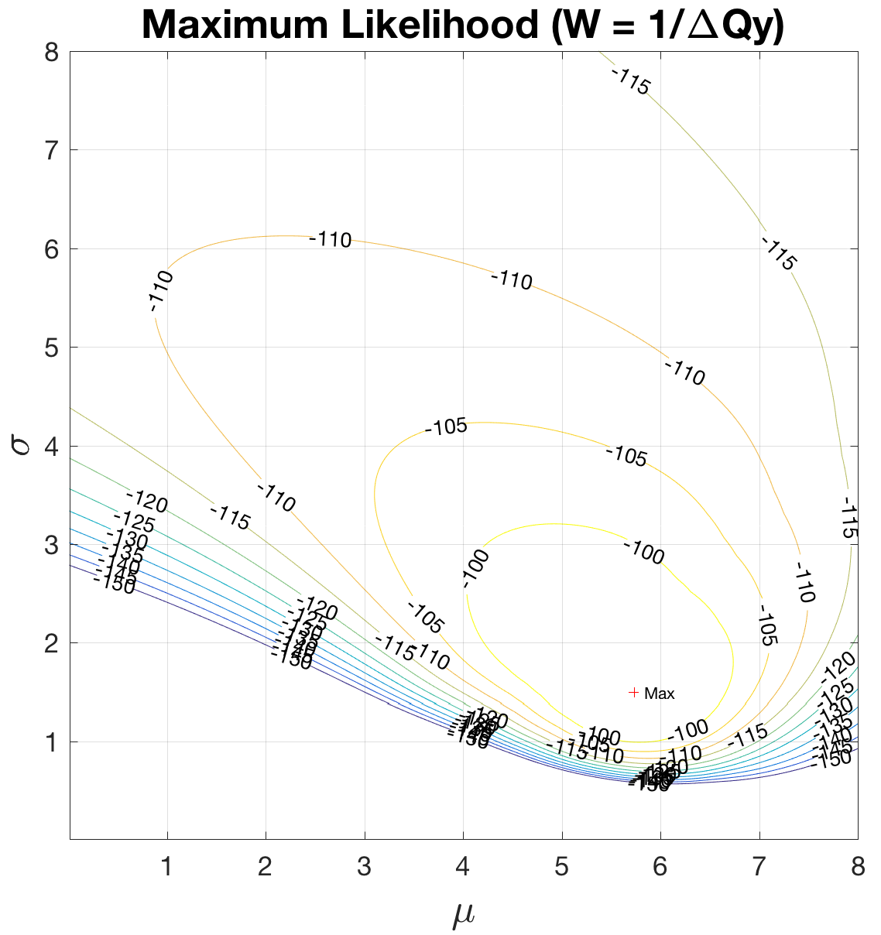
Weighted Likelihood
Summed Likelihood: -90
Need context for this value

Slide 26
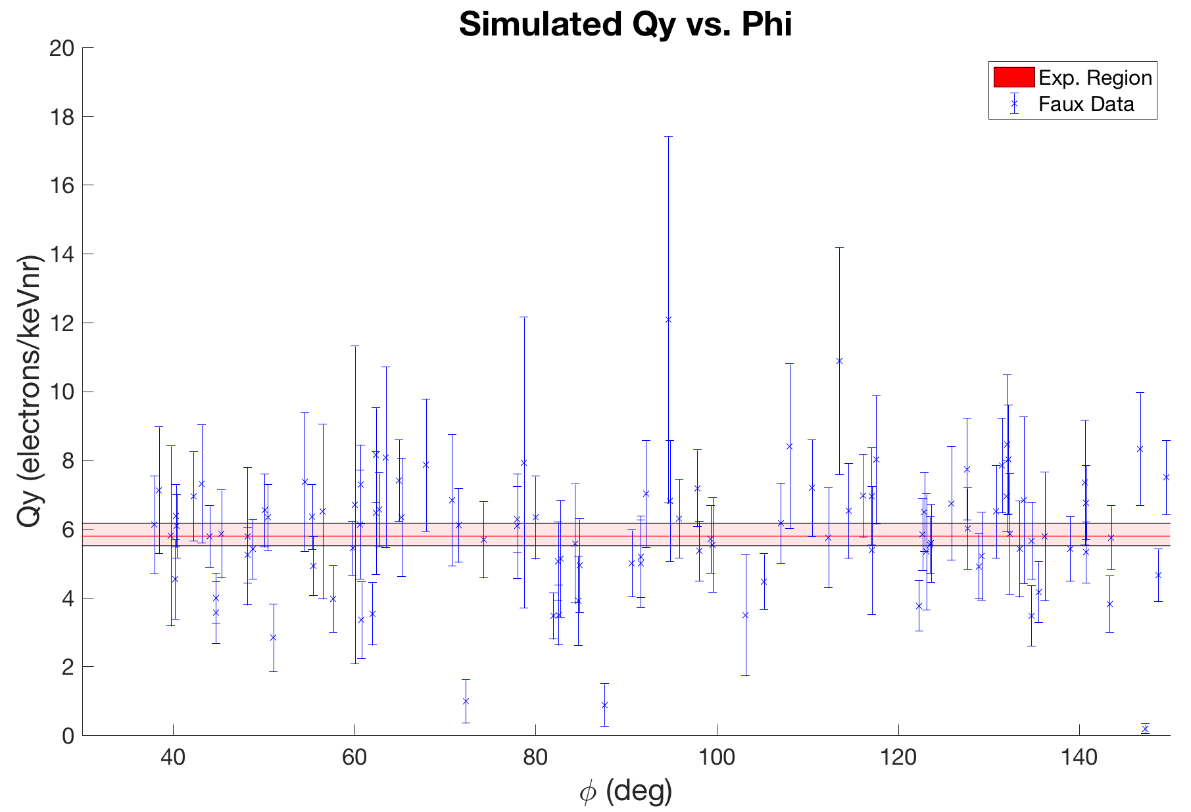
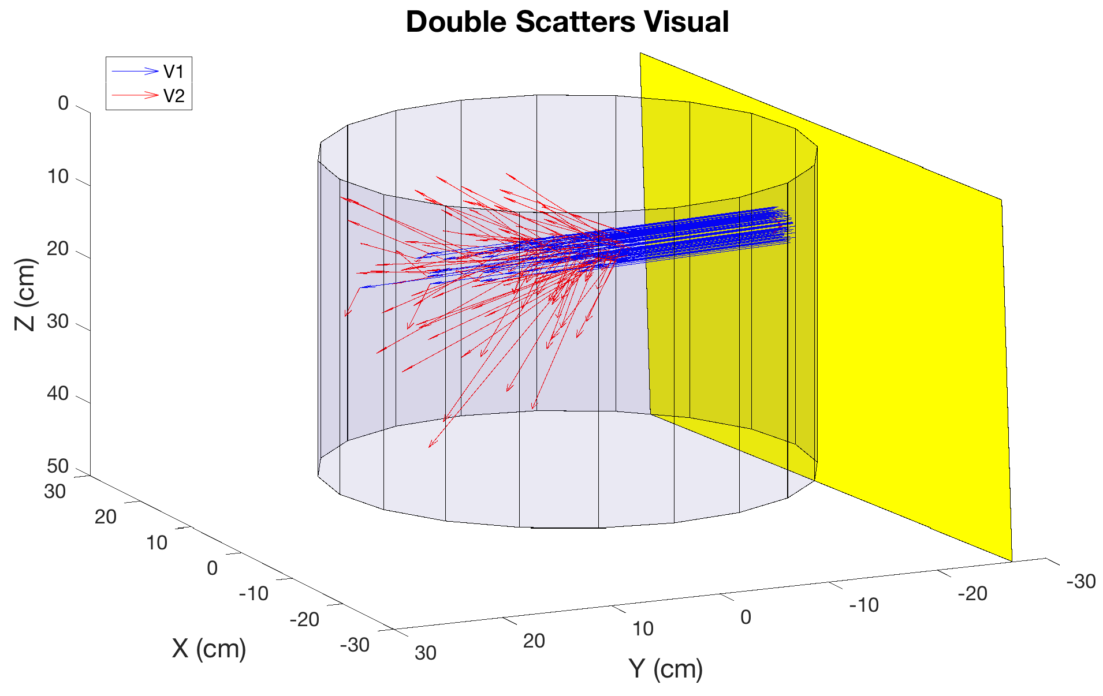
Likelihood Normalization
Simulate 1000’s of random Qy vs. φ datasets
Cumulatively bin summed likelihood values
Place real data within cumulative distribution

Slide 27
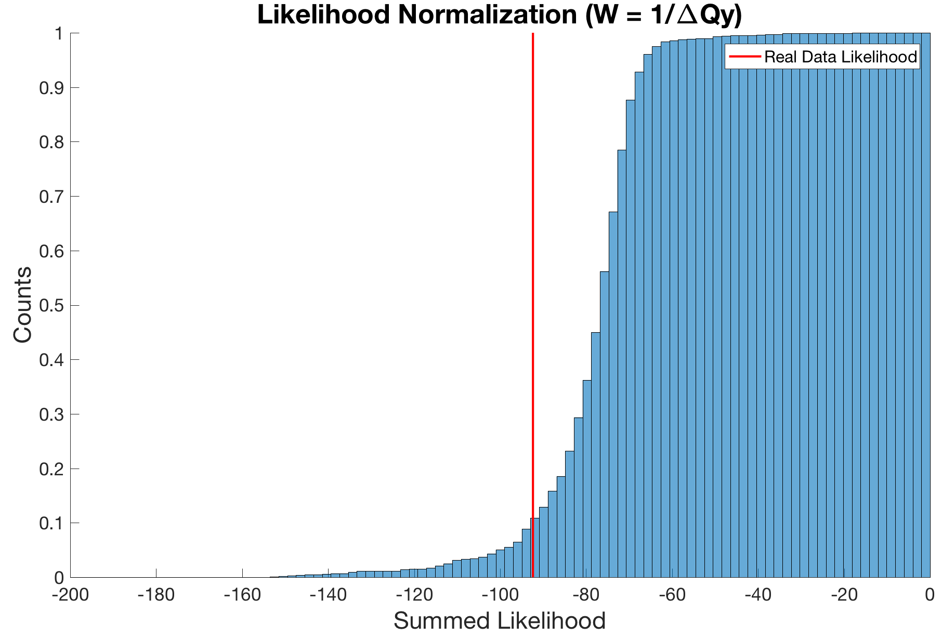
Likelihood Normalization
Interpretation:
If real data comes from PDF, 15% chance that real data has worse likelihood.
Not ideal but not unrealistic

Slide 28
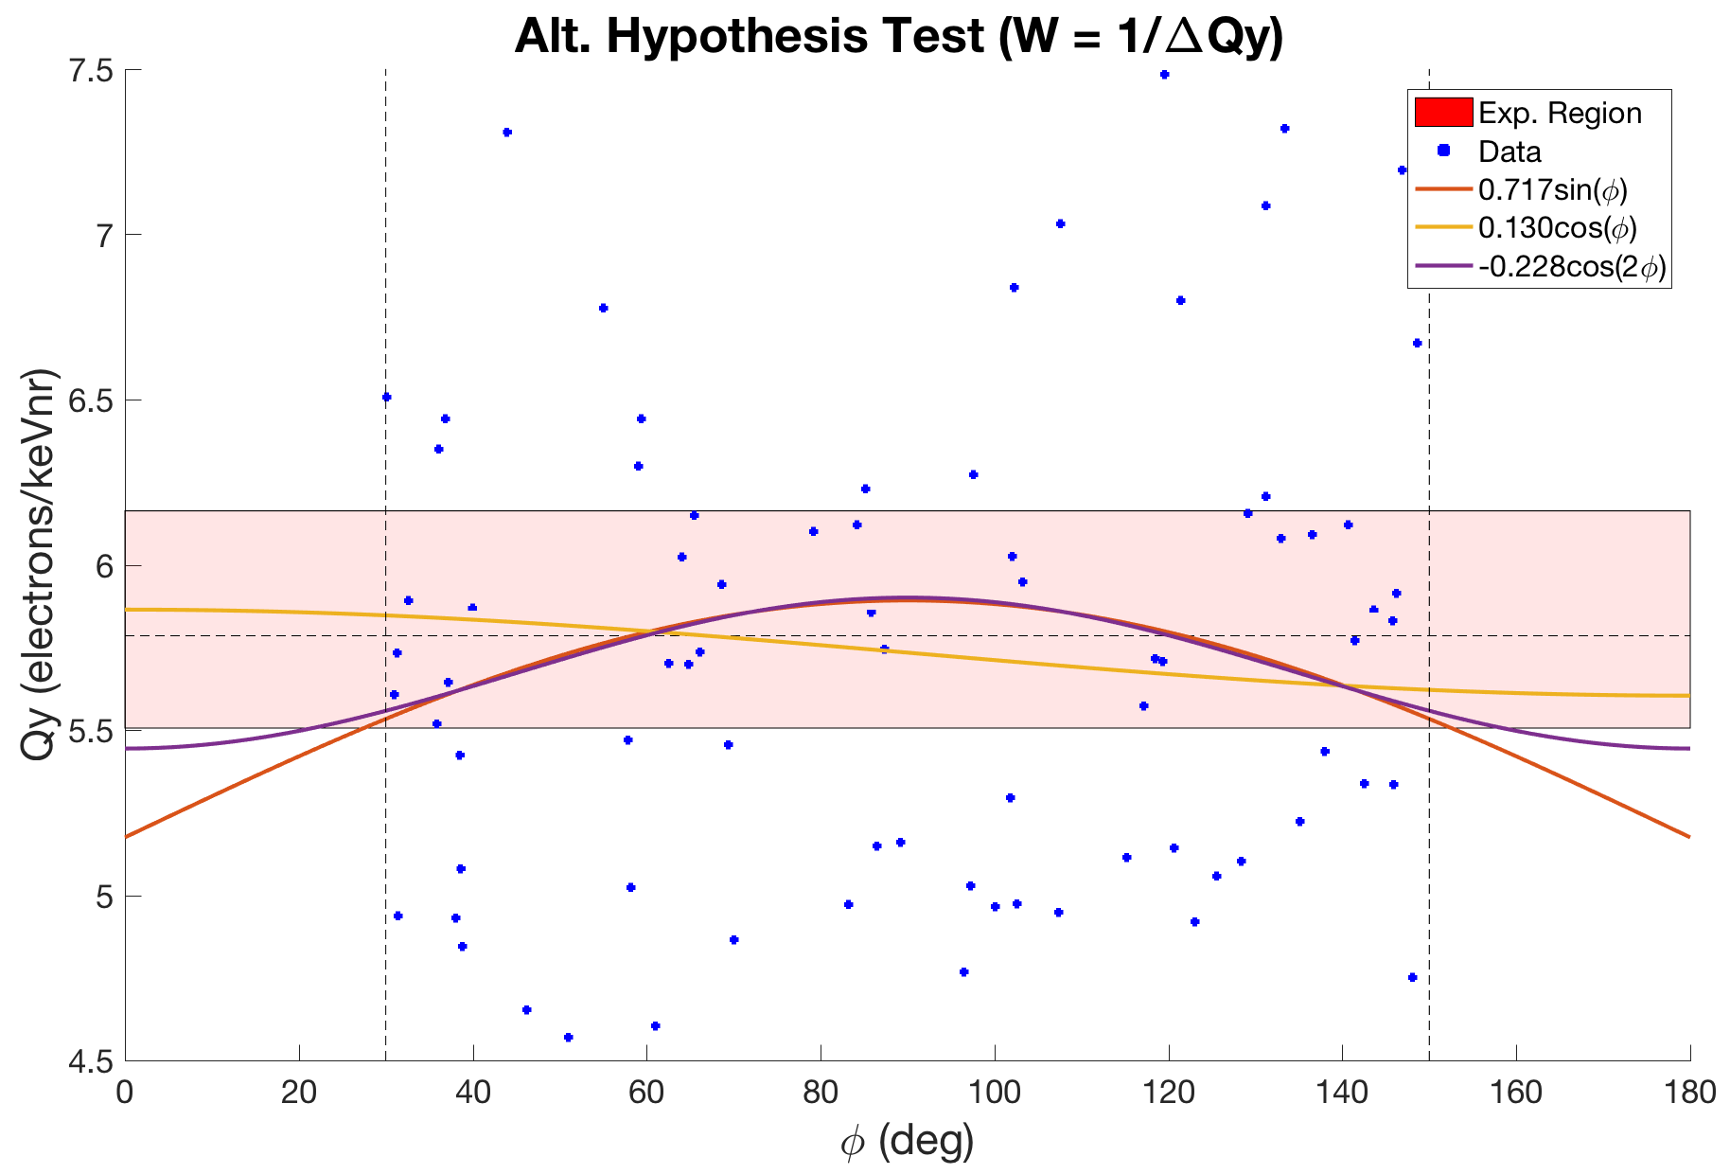
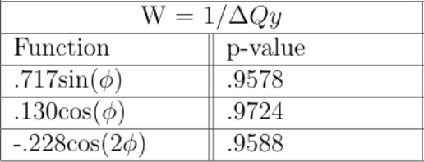
Alternate Hypothesis Results
Results:
Interpretation:
p-value: Probability of finding observed result if null hypothesis were true

Slide 29
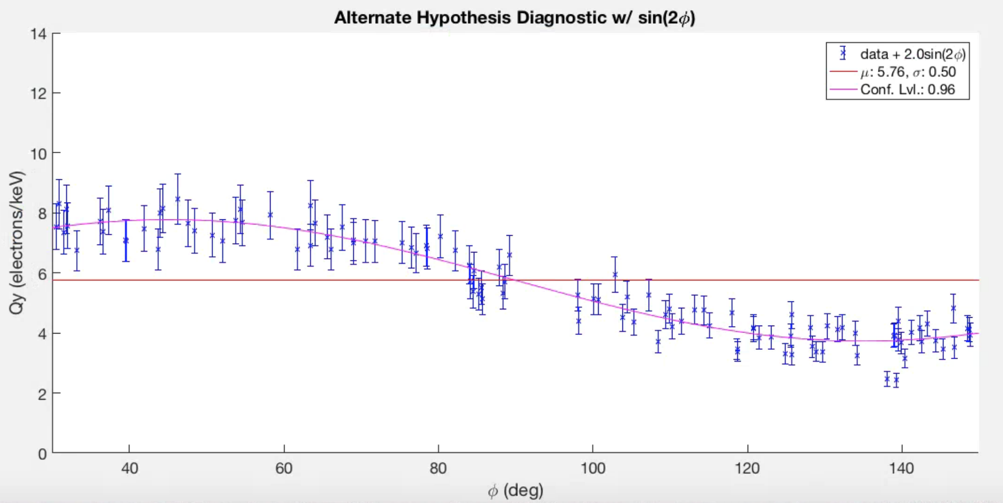
Alternate Hypothesis Test Validation
To ensure the analysis framework was correct:
Fake dataset
Injected sinusoidal dependence
Ran hypothesis test
p-value: .04
Can reject null hypothesis w/ 96% confidence

Slide 30
Conclusions + Further Work
Any φ dependence in S2 is below detection threshold
Must continue to characterize high Qy vals
Weighted likelihood disproportionately emphasizes low Qy vals
Look for ways to improve Monte Carlo for normalization
Continue to validate results

Slide 31
Acknowledgements
Rick Gaitskell
Casey Rhyne, Will Taylor, DQ Huang, Samuel Chan
Friends and Family

Slide 32
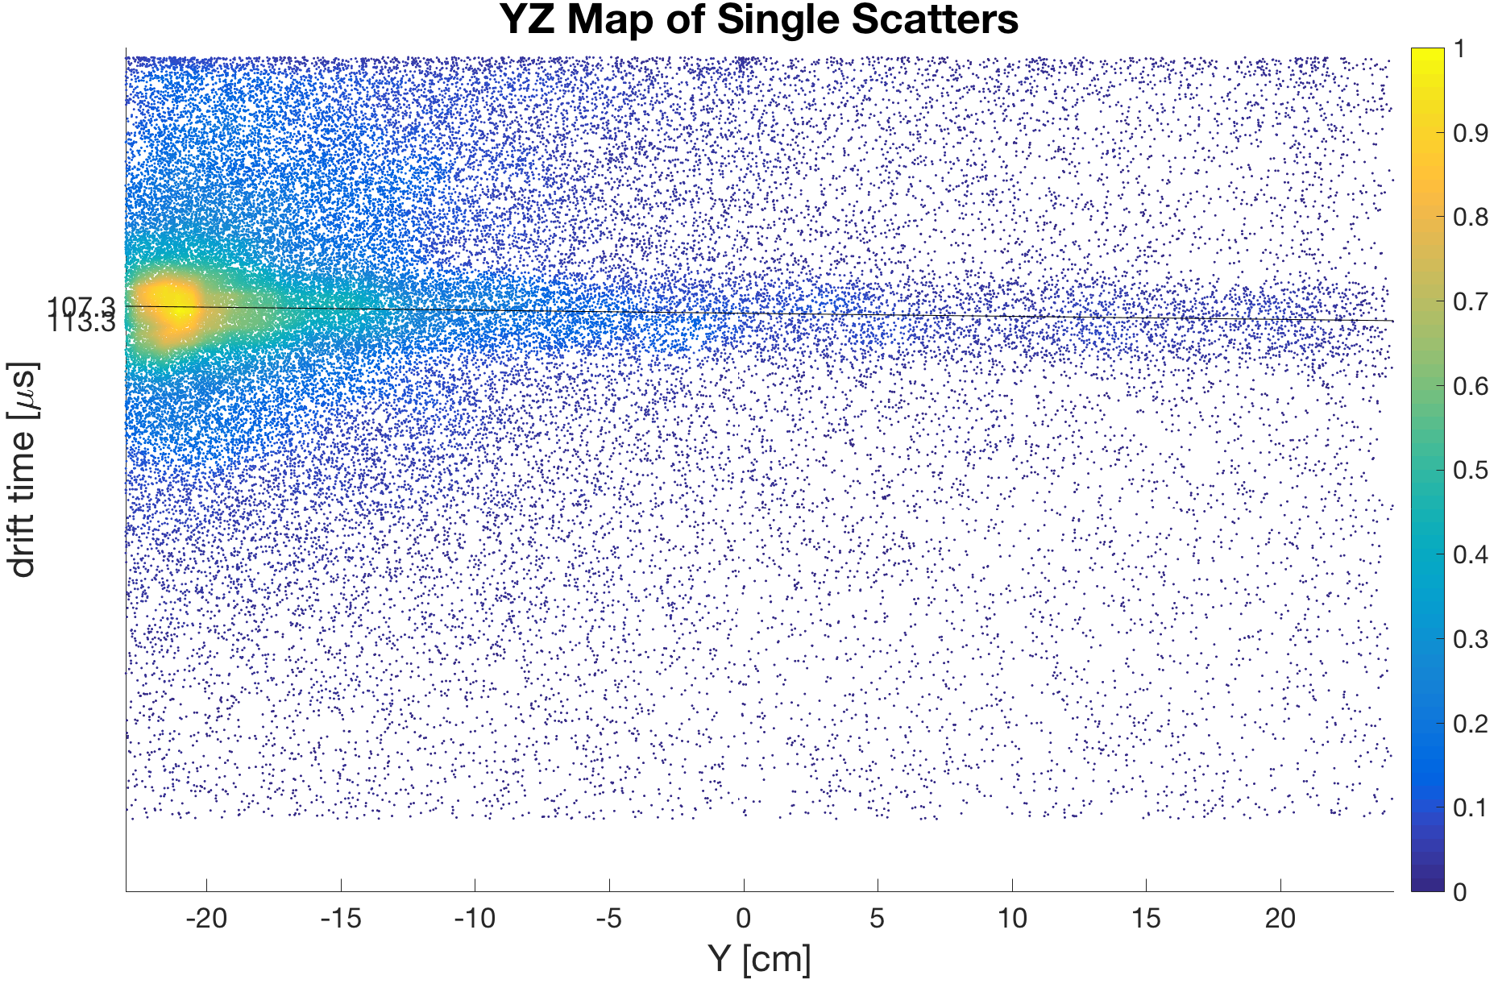
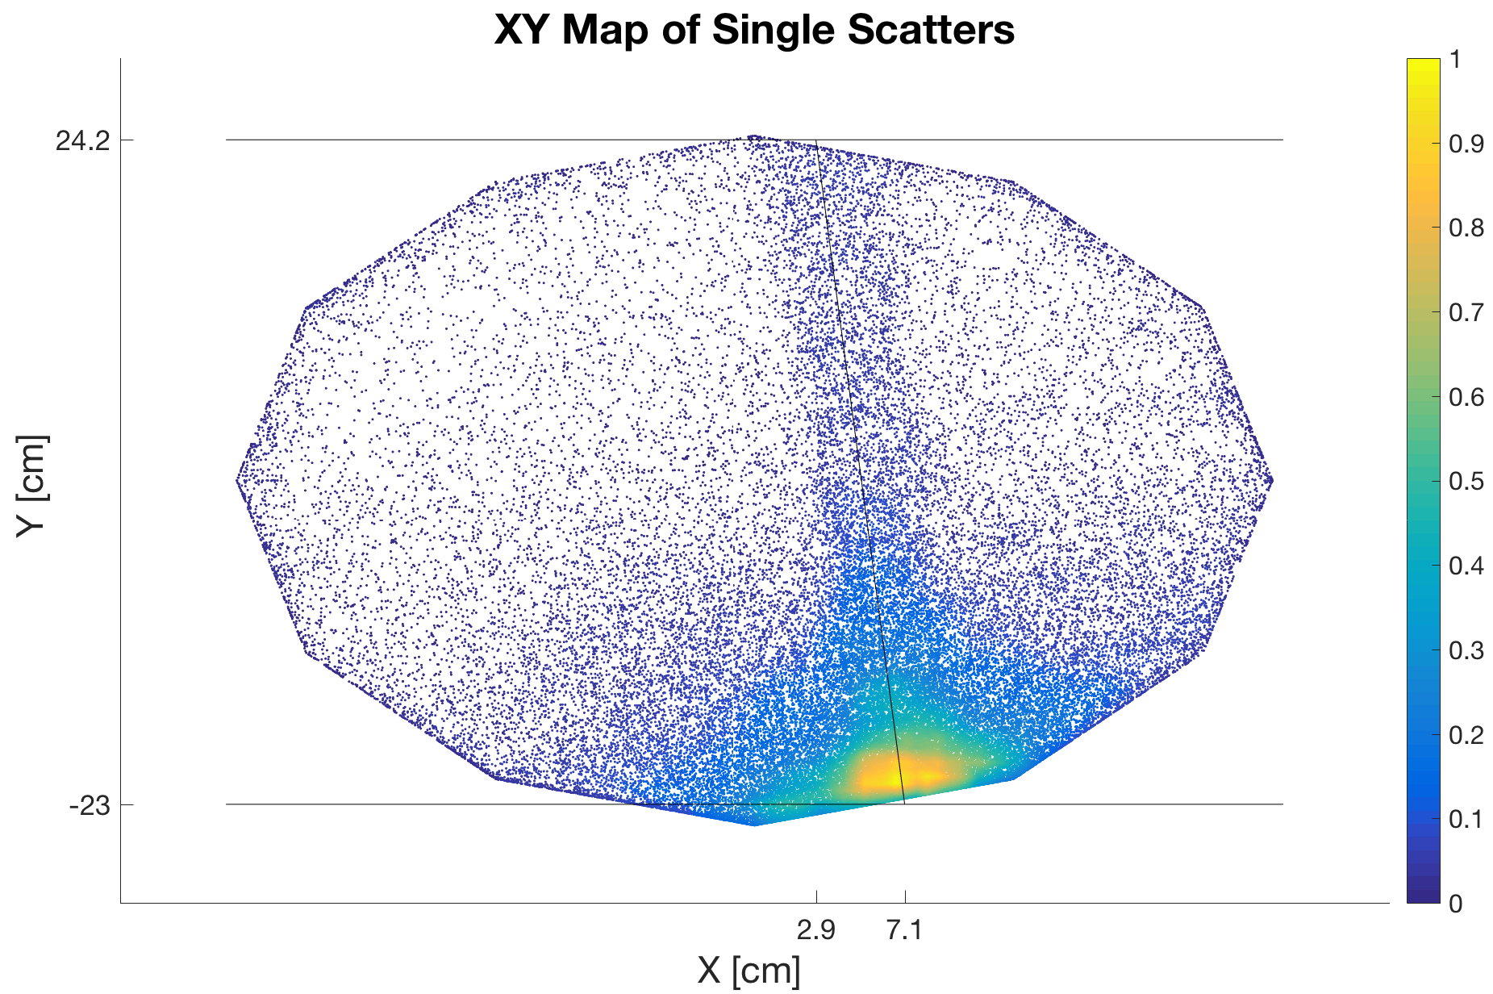
Neutron Beam Position Verification
Entry: (7.1, -23.0, 16.1) cm
Exit: (2.9, 24.2, 17.0) cm

Slide 33
Making the Measurement
Can approximate LUX E-field as vertical
Define φ to be angle between Xe recoil track and vertical
Note: Xe nuclear recoil track is greatly exaggerated
Variables we know: P0, P1, P2, and ϴ_{LAB}
From Classical Mechanics:
Relationship between CM and LAB angles?

Slide 34
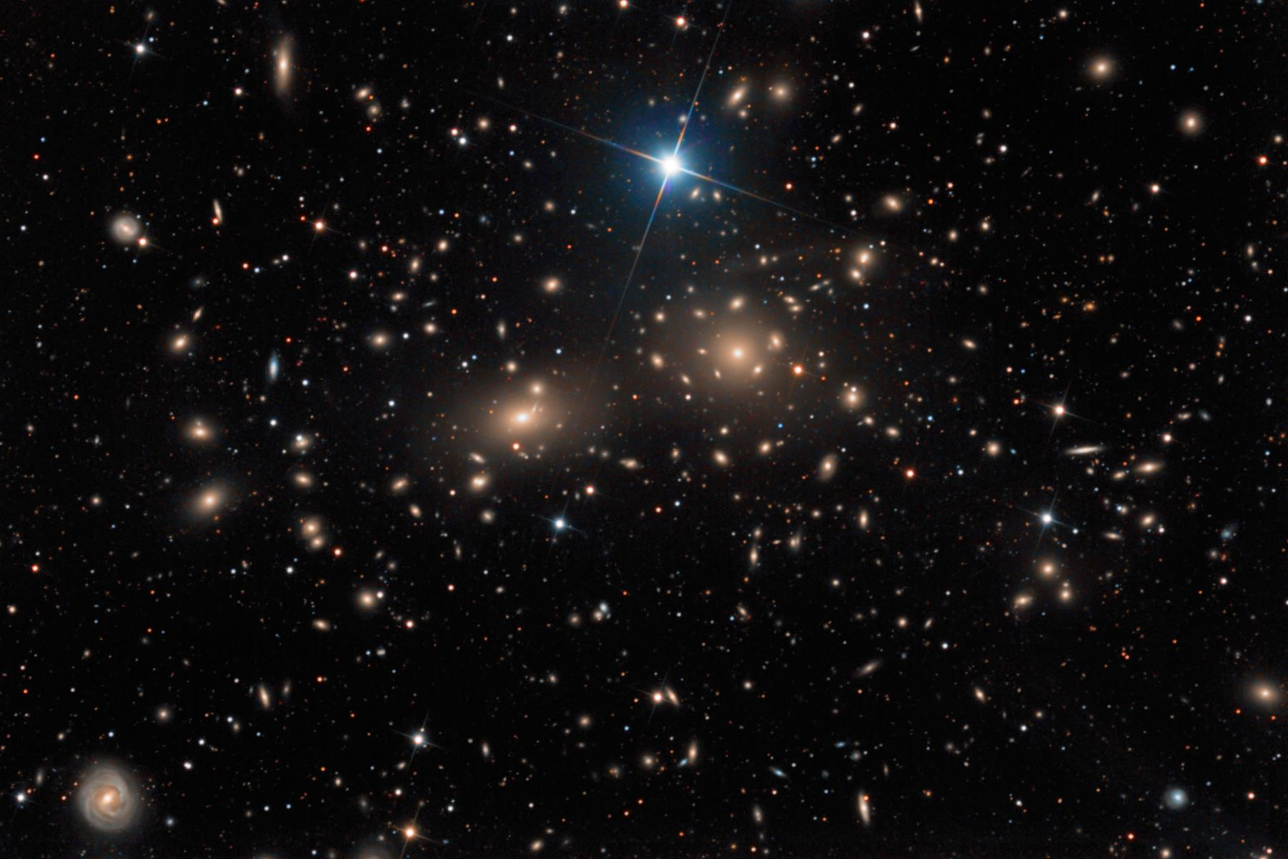
Origin of Dark Matter
1932 - Fritz Zwicky & the Coma Galaxy Cluster:
Measured velocities of galaxies and used classical mechanics to estimate total mass (M)
Measured total luminosity (L)
Compared to known L/M ratio of stellar system
Off by a factor of 100!
Conclusion: non-luminous, “dark matter” must contribute to total mass
Notes:
Coma cluster: over 1000 galaxies ~321 million light years from Earth.
https://en.wikipedia.org/wiki/Coma_Cluster
http://www.learner.org/courses/physics/unit/text.html?unit=10&secNum=2

Slide 35
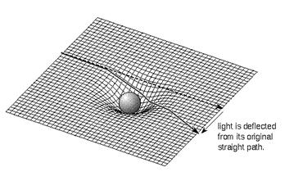
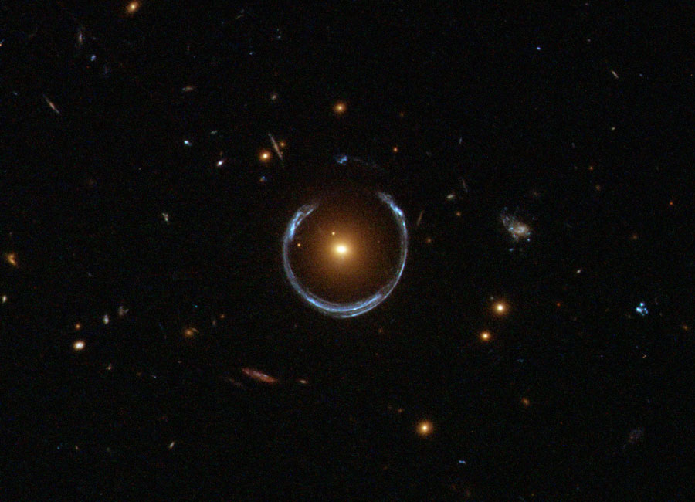
Evidence for Dark Matter - Gravitational Lensing
Einstein’s Theory of General Relativity (1916):
Light gets distorted in various ways (i.e. horseshoe ring):
Hubble Telescope (2011)
Massive objects bend the fabric of space
Geometry of lensing infers the existence of unseen mass

Slide 36
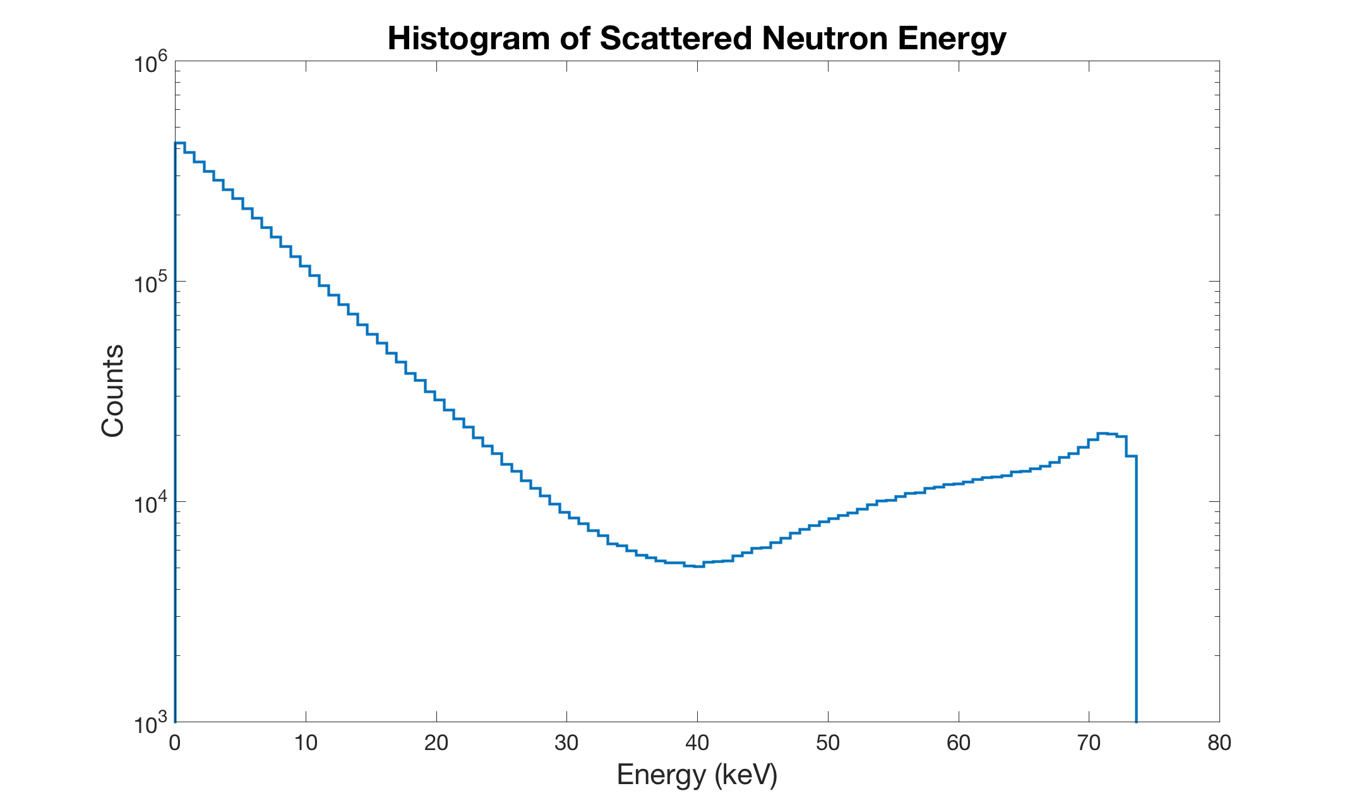
Selecting Energy Range
Three factors determine energy range:
More energy = longer Xe recoil track
More neutron scatters at lower energies
  Cross section is energy dependent
Less energy = greater range of φ values
  min φ = ϴ/2 & max φ = 𝜋 - min φ
Chose 45º < ϴ < 55º → 10.76 keV < Enr < 15.67 keV

Slide 37
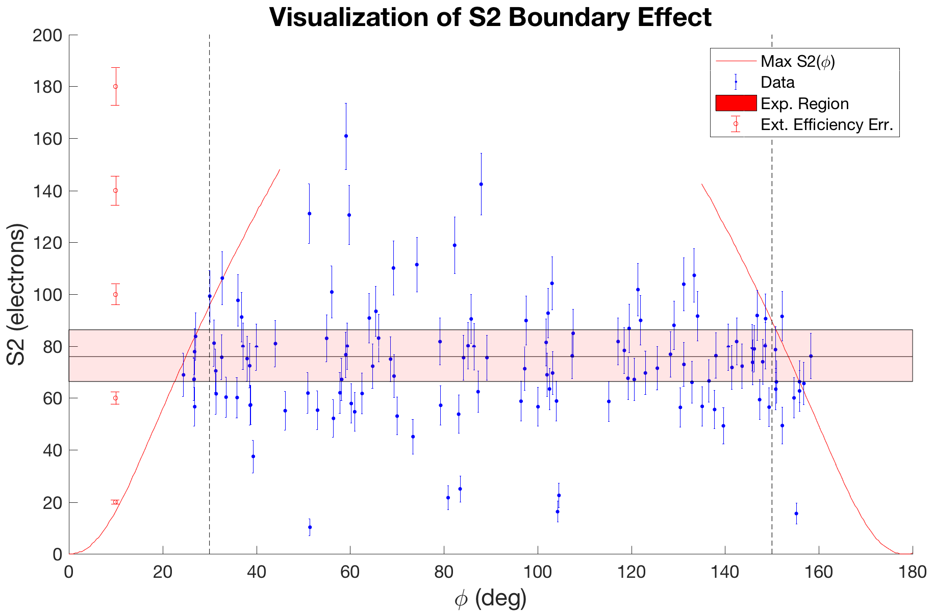
S2 vs. φ
S2 Units (23.77 phd/e⁻)
Extr. Eff. (48% ± 4%)
126 Events shown
S2 expectation curves from NEST
Higher expected S2 means higher ϴ
This limits events that appear at corresponding φ
Cut for 30º < φ < 150º

Slide 38
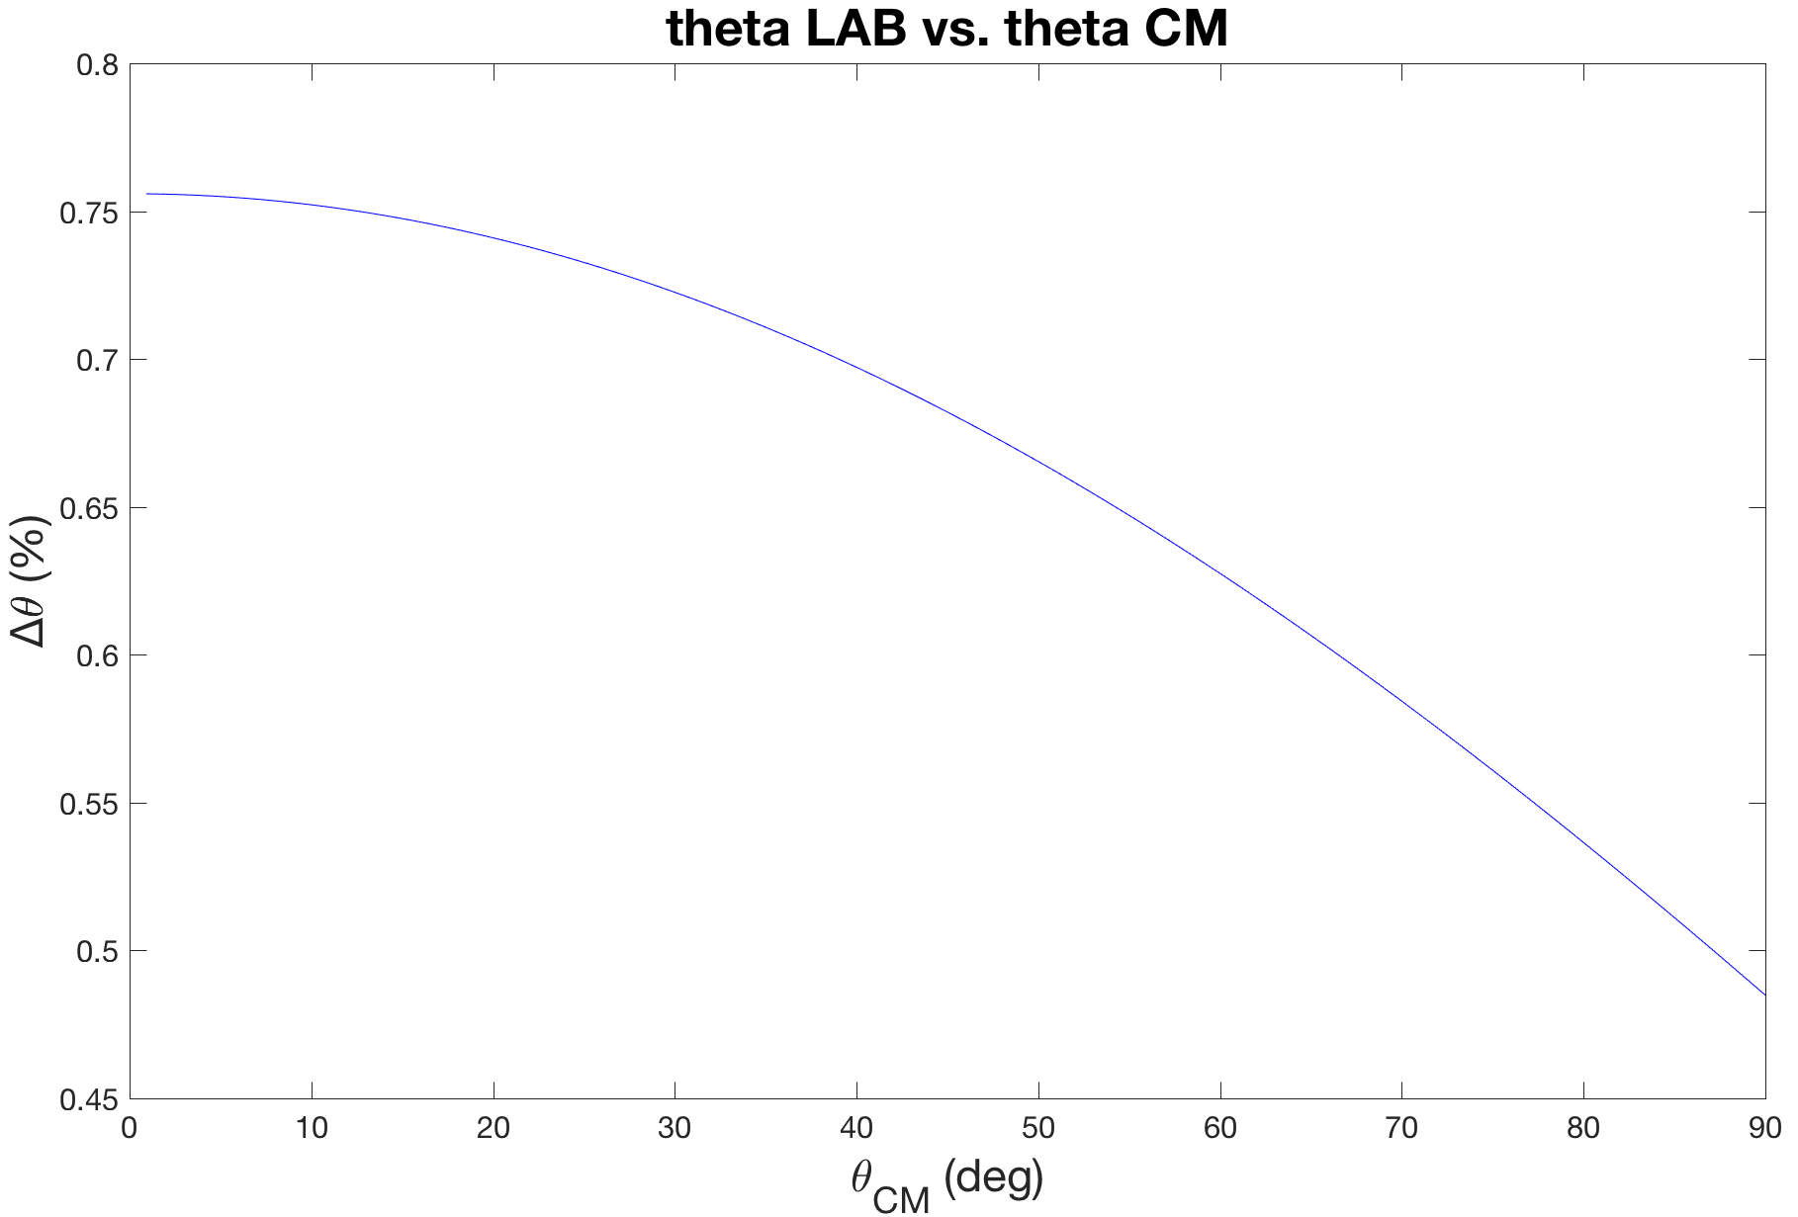

Making the Measurement
Mass of Xe >> Mass of neutron
Therefore CM approximation is good
Max 0.76% difference for angle range of interest

Slide 39
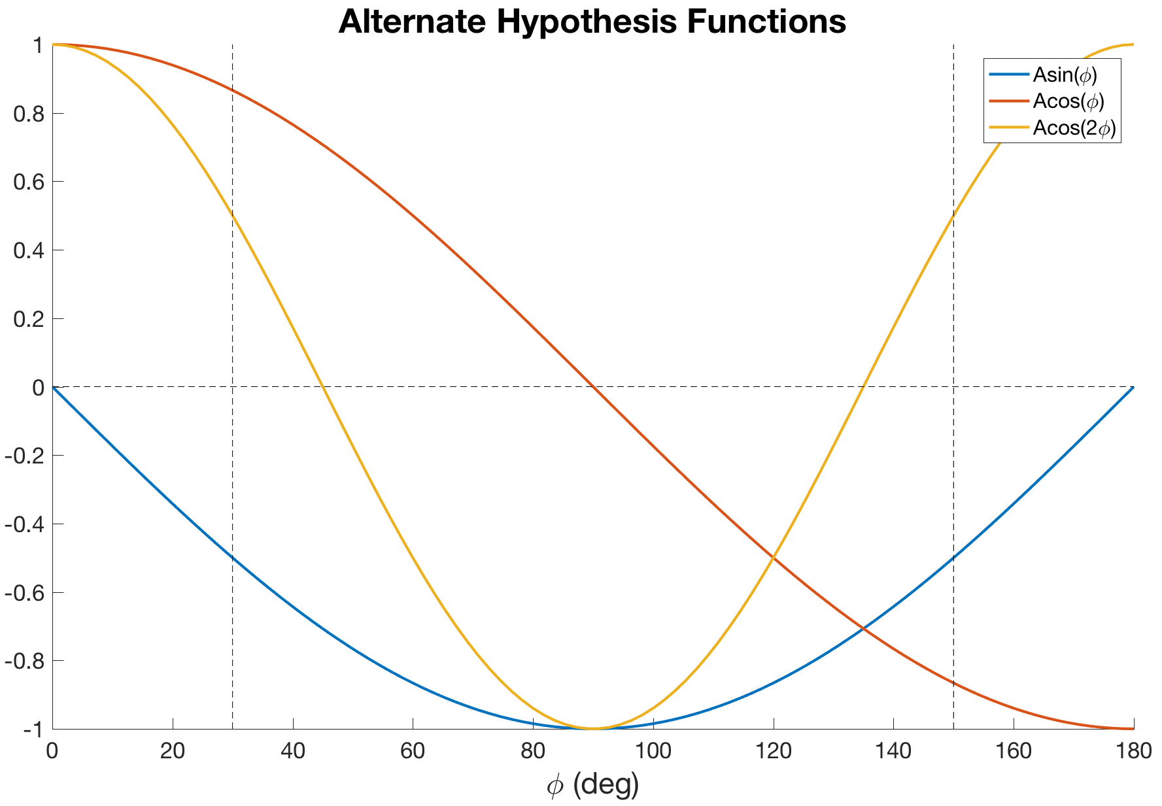
Hypothesis Testing
Expect difference btwn 30º,150º φ and 90º φ
Tested the following functions:
Asin(φ)
Acos(φ)
Acos(2φ)
Let parameter, A, vary

